Slide 1
Keyboard Shortcuts for Jupyter Notebook

Slide 2
Running Code
Shift + enter
Anywhere in the cell
Don’t need to highlight the code

Slide 3
Toggling between code and cell mode
esc
See how it changes color?
Green: code
Blue: the cell itself

Slide 4
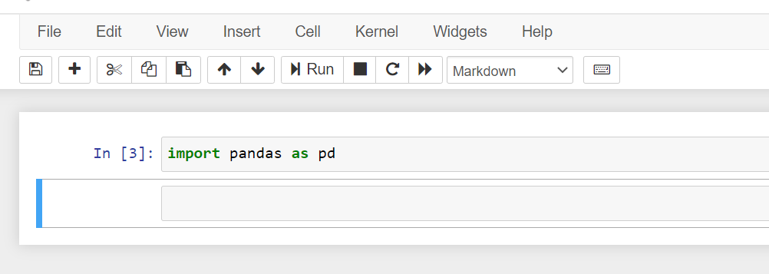
Markdown mode
esc (blue) then m

Slide 5
Add Closing Marks with Ease
Highlight your code
Put one opening mark at the beginning and the ending mark will appear
“
‘
(
[
{

Slide 6
Highlight Multiple Cells
shift + j when in blue
Can copy and paste them into a new notebook
Can move them up and down within the same notebook

Slide 7
Copy / Paste
ctrl + c / cmd + c
ctrl + v / cmd + v

Slide 8
Undo
ctrl + z / cmd + z
Have to be clicked in the cell to do it
Won’t work once you’ve saved changes

Slide 9
Is my code done yet?
The * tells you so

